Slide 1
Computers Principles 8 Lecture/ WINDOWS 7
Civil Engineering Department College of Engineering / Diyala University
Dr. Qasim Adnan Aljanabi

Slide 2
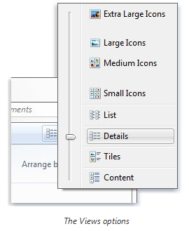
Viewing and arranging files and folders
When you open a folder or library, you can change how the files look in the window.
To make these kinds of changes, use the Views
button in the toolbar.
Each time you click the left side of the Views button, it changes the way your files and folders are displayed by cycling through five different views.
If you click the arrow on the right side of the
Views button, you have more choices. Move
the slider up or down to fine-tune the size of
the file and folder icons. You can see the
icons change size as you move the slider.

Slide 3
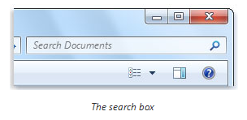
Finding files
Depending on how many files you have and how they are organized, finding a file might mean browsing through hundreds of files and subfolders—not an easy task.
The search box filters the current view based on the text that you type.
Files are displayed as search results if your search term matches the file's name, tags or other properties, or even the text inside a text document.
If you're searching for a file based on a property (such as the file's size), you can narrow the search before you start typing by clicking the search box, and then clicking one of the properties just below the search box. This adds a search filter(such as “size") to your search text, which will give you more accurate results.

Slide 4
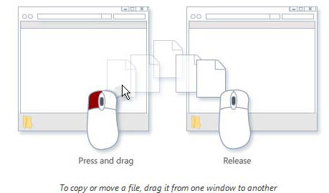
Copying and moving files and folders
You might want to move files to a
different folder.
Most people copy and move files using
a method called drag and drop.
When using the drag-and-drop method, you might notice that sometimes the file or folder is copied, and at other times it's moved.
Tips
• The easiest way to arrange two windows on the desktop is to use Snap.
• If you copy or move a file or folder to a library, it will be stored in the library's default save location.
• Another way to copy or move a file is to drag it from the file list to a folder or library in the navigation pane so you don't need to open two separate windows.

Slide 5
Creating and deleting files
The most common way to create new files is by using a program.
By default, most programs save files in common folders like My Documents and My Pictures, which makes it easy to find the files again next time.
When you no longer need a file, you can remove it from your computer to save space and to keep your computer from getting cluttered with unwanted files.
When you delete a file, it's temporarily stored in the Recycle Bin. Think of the Recycle Bin as a safety net that allows you to recover files or folders that you might have accidentally deleted.

Slide 6
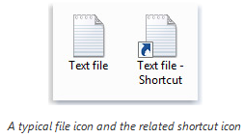
Create or delete a shortcut
A shortcut is a link to an item (such as on the a file, folder, or program) on your computer.
You can create shortcuts and then place them in a convenient location, such as on the desktop or in the navigation pane(the left pane) of a folder .
Shortcuts can be distinguished from the original file by the arrow that appears icon.
To create a shortcut
Open the location containing the item that you want to create a shortcut.
2. Right-click the item, and then click Create shortcut. The new shortcut appears in the same location as the original item.
3. Drag the new shortcut to the desired location.

Slide 7
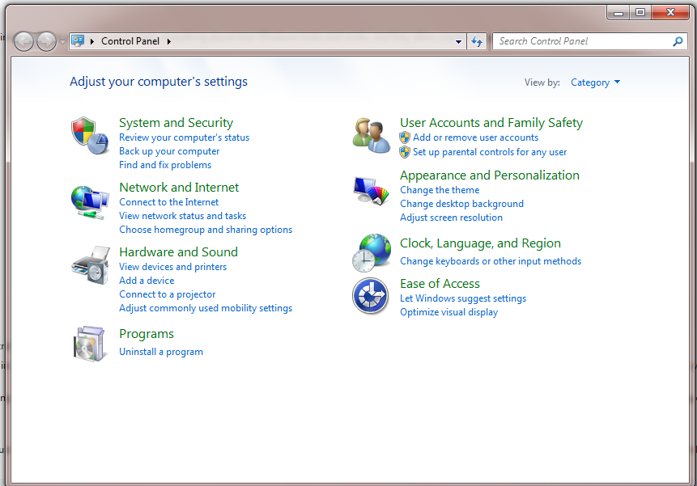
Working with Control Panel
You can use Control Panel to change settings for Windows.
You can use two different methods to find the Control Panel item you are looking for:
1- Use Search. To find a setting you are interested in or a task you want to perform, enter a word or phrase in the search box.
2- Browse. You can explore Control Panel by clicking different categories (for example, System and Security, Programs, or Ease of Access).

Slide 8
THANK - YOU

